Slide 1
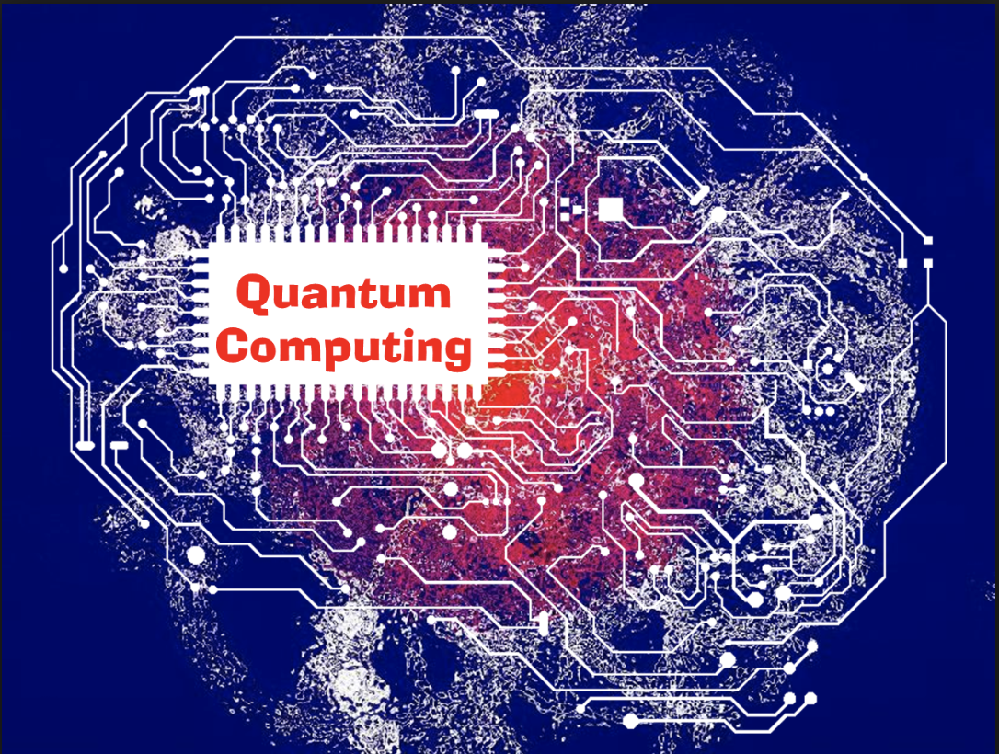
Quantum Deep Learning
Undergraduate Study #3
Hanjin Choi, Myungwoo Song. Korea University, School of Electrical Engineering
zxa018@korea.ac.kr
erados@korea.ac.kr

Slide 2
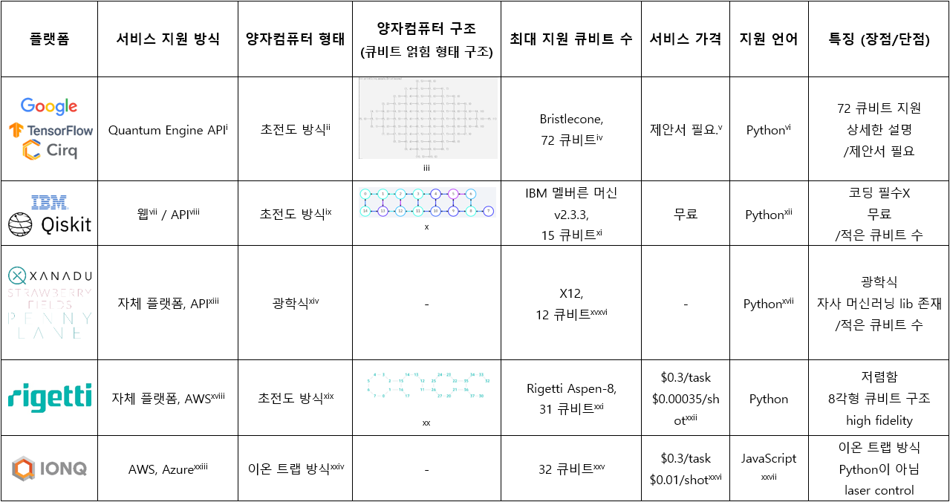
양자 컴퓨팅 플랫폼 조사

Slide 3
자료 출처
^{[i]} https://cirq.readthedocs.io/en/stable/docs/google/engine.html
^{[ii]} https://ai.googleblog.com/2018/03/a-preview-of-bristlecone-googles-new.html
^{[iii]} https://cirq.readthedocs.io/en/stable/generated/cirq.google.Bristlecone.html
^{[iv]} https://cirq.readthedocs.io/en/latest/docs/google/devices.html#bristlecone
^{[v]} https://cirq.readthedocs.io/en/stable/docs/google/concepts.html#About-Quantum-Computing-Service
^{[vi]} https://github.com/quantumlib/Cirq
^{[vii]} https://quantum-computing.ibm.com/
^{[viii]} https://qiskit.org/textbook/ch-appendix/qiskit.html#Accessing-on-real-quantum-hardware
^{[ix]} https://en.wikipedia.org/wiki/List_of_quantum_processors
^{[x]} https://quantum-computing.ibm.com/
^{[xi]} https://quantum-computing.ibm.com/
^{[xii]} https://qiskit.org/documentation/install.html
^{[xiii]} https://strawberryfields.ai/photonics/demos/tutorial_X8.html#configuring-your-credentials
^{[xiv]} https://strawberryfields.ai/photonics/hardware/details.html
^{[xv]} https://venturebeat.com/2020/09/02/xanadu-photonics-quantum-cloud-platform/
^{[xvi]} https://github.com/XanaduAI/strawberryfields/blob/master/strawberryfields/engine.py
^{[xvii]} https://strawberryfields.readthedocs.io/en/stable/development/development_guide.html
^{[xviii]} https://aws.amazon.com/ko/braket/
^{[xix]} https://www.rigetti.com/what
^{[xx]} https://medium.com/swlh/exploring-quantum-computing-with-rigetti-pyquil-mid-2020-edition-70b28f917670
^{[xxi]} https://www.rigetti.com/
^{[xxii]} https://aws.amazon.com/ko/braket/pricing/
^{[xxiii]} https://ionq.com/get-started
^{[xxiv]} https://ionq.com/technology
^{[xxv]} https://ionq.com/news/october-01-2020-most-powerful-quantum-computer
^{[xxvi]} https://aws.amazon.com/ko/braket/pricing/
^{[xxvii]} https://github.com/ionq

